Slide 1
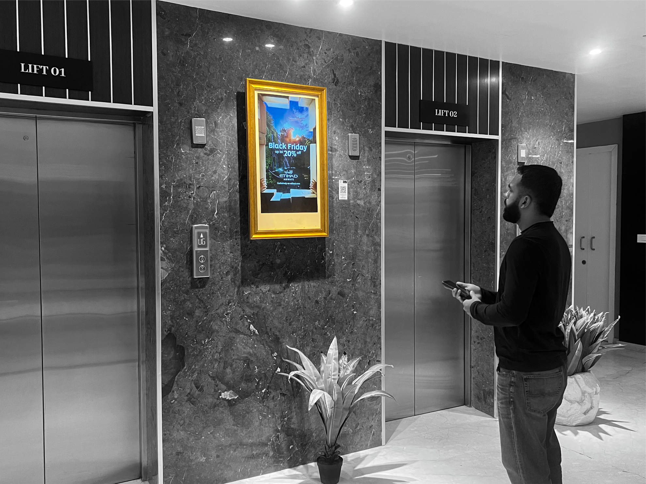
Digital-Indoors Residential
ACTUAL PRICE
SPECIFICATIONS
2,500/-
+18% GST PER MONTH PER
SCREEN
AD DURATION:
10-SECONDS
FILE FORMAT:
JPEG, PNG, MP4
DAILY IMPRESSIONS:
360
SCREEN RESOLUTION:
W1080 X H1920 PX

Slide 2
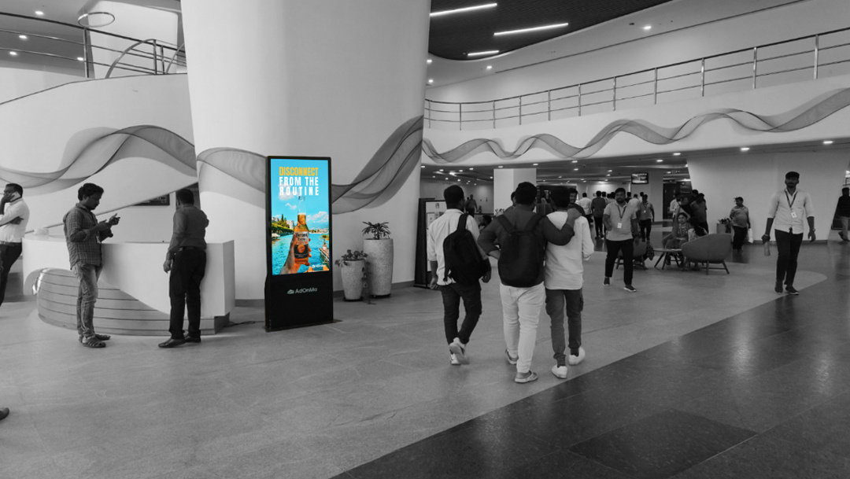
Digital- Corporate
ACTUAL PRICE
SPECIFICATIONS
12,000/-
+18% GST PER MONTH PER
SCREEN
AD DURATION:
10-SECONDS
FILE FORMAT:
JPEG, PNG, MP4
DAILY IMPRESSIONS:
210
SCREEN RESOLUTION:
W1080 X H1920 PX

Slide 3
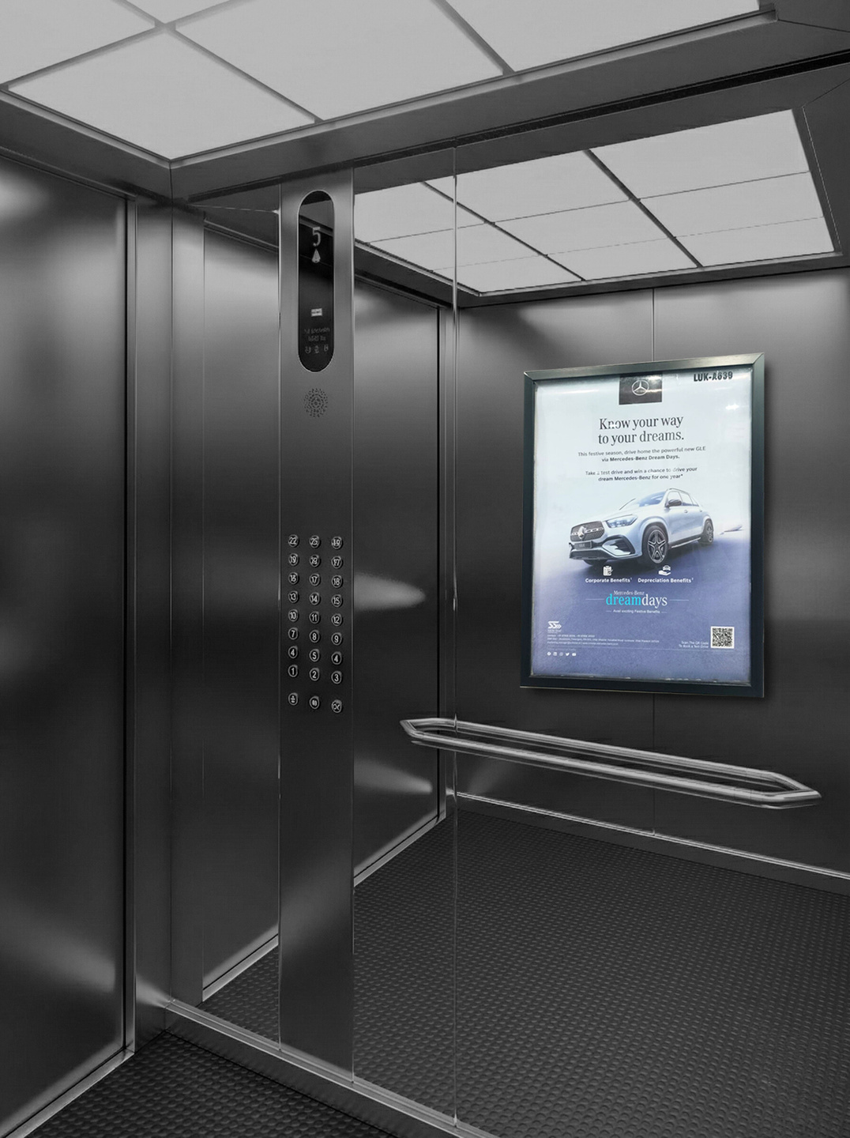
Static-Poster Frames
ACTUAL PRICE
SPECIFICATIONS
2,000/-
+18% GST PER MONTH PER
POSTER
POSTER SIZE:
A2

Slide 4
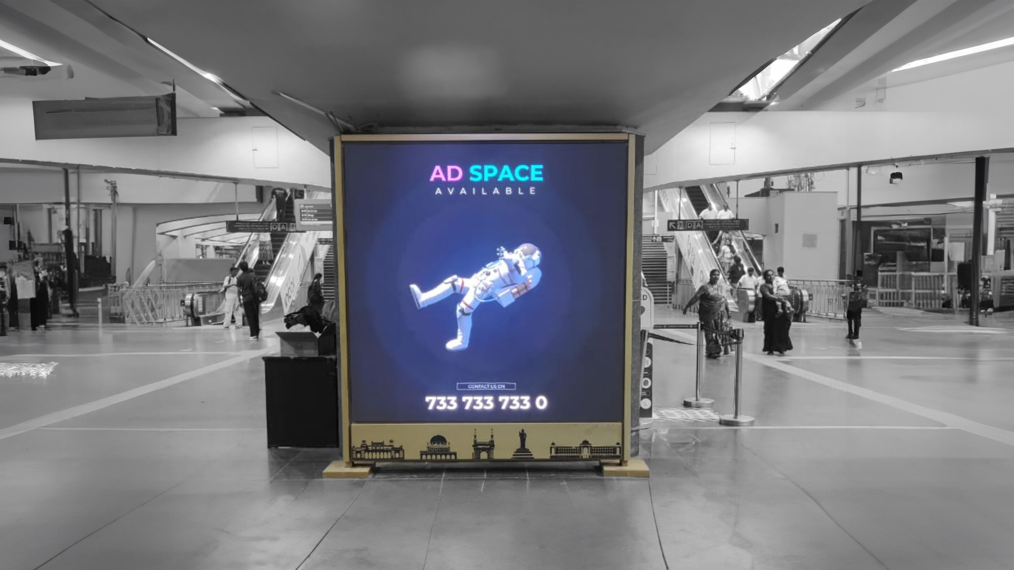
Metro Station
ACTUAL PRICE FOR ALL THE STATIONS EXCEPT AMEERPET
SPECIFICATIONS
2,50,000/-
+18% GST PER MONTH PER
STATION
ACTUAL PRICE FOR AMEERPET STATION
5,20,000/-
+18% GST PER MONTH PER
STATION
AD DURATION:
15-SECONDS
FILE FORMAT:
JPEG, PNG, MP4
DAILY IMPRESSIONS:
340
SCREEN RESOLUTION:
W1080 X H1920 PX

Slide 5
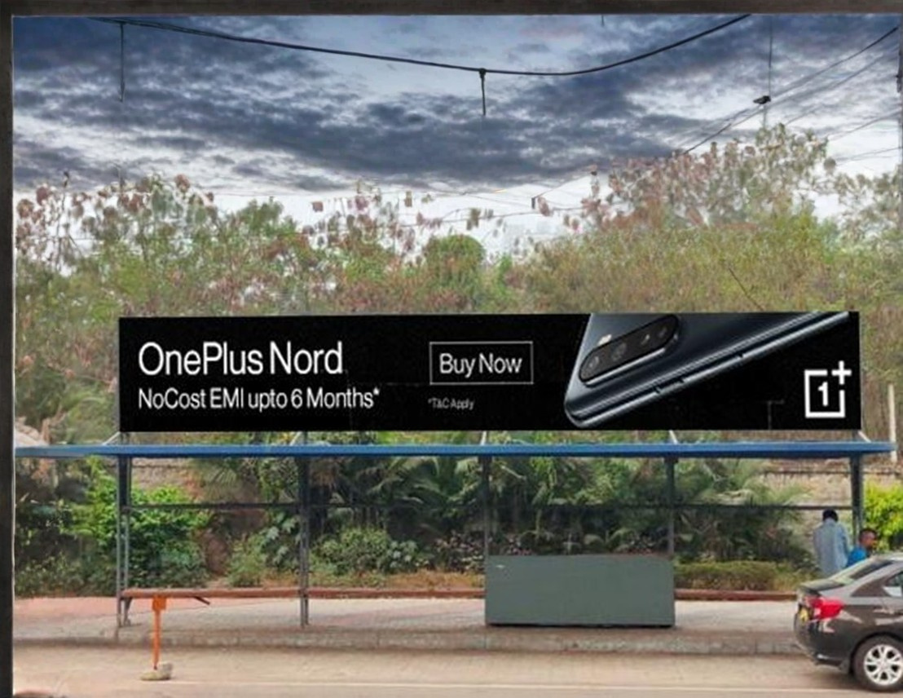
Metro Parking Shelters
ACTUAL PRICE
SPECIFICATIONS
60,000/-
+18% GST PER MONTH PER
SCREEN
SIZE :
33” FEET WIDTH
5” FEET HEIGHT
TOTAL NO.OF BOARDS
110

